Slide 1
Predicting Voter Turnout in Texas

Slide 2
Problem Statement
The DNC wants to investigate factors influencing voter turnout and election results. Texas is of particular interest because of its size, demographic changes, and fluctuating voting laws.

Slide 3
Overview
Part 1: Problem Statement & Data Collection
Reasons to Investigate Voter Turnout in Texas
Texas Demographics and Voting History
Part 2: Modeling to Predict Turnout and Election Results
Predicting Voter Turnout using LASSO Regression
Predicting Election Results by Expected Party Turnout

Slide 4
Background
Demographics & Voting Laws

Slide 5
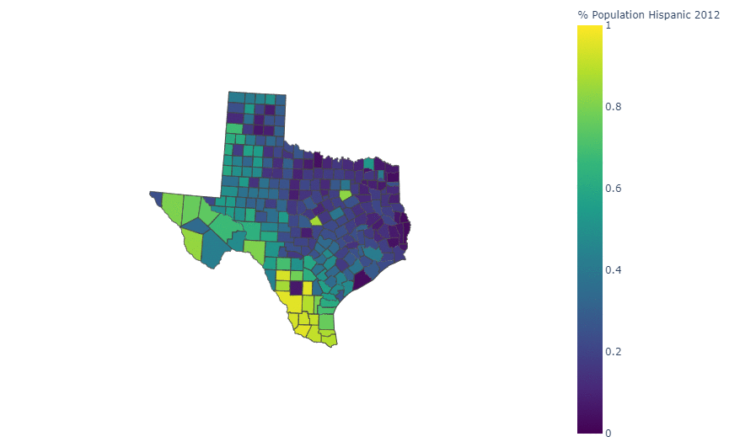
Texas Hispanic Population:
State Demographers predict Hispanics will become the state’s largest population group by mid-2021
Hillary Clinton won the Texas Hispanic vote by 27% in 2016

Slide 6
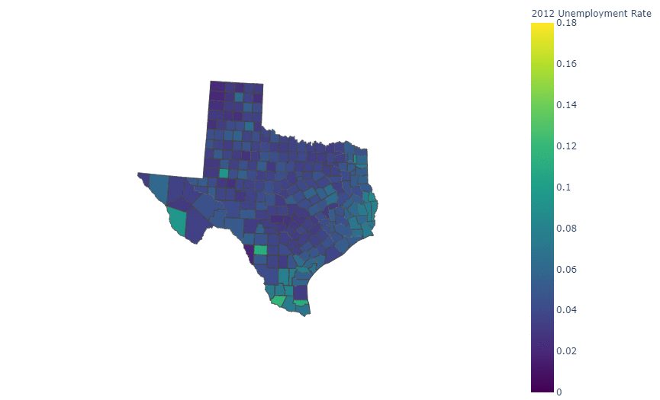
Texas Unemployment:
Unemployment is much higher in 2020 due to Covid
Counties close to the border tend to have higher unemployment rates

Slide 7
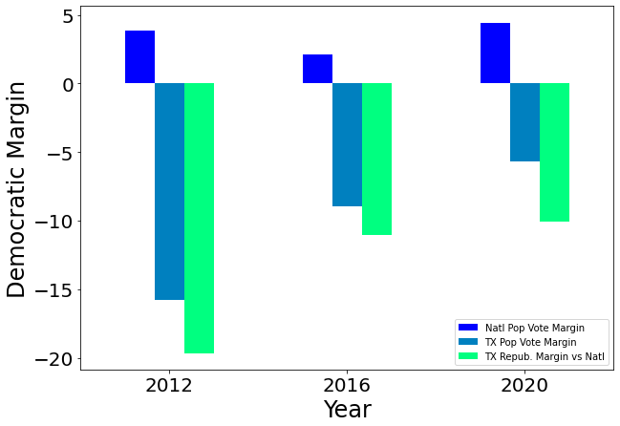
Will Texas go Blue?
Texas has not voted for a Democratic President since Jimmy Carter in 1976
Demographics point toward a blue shift in Texas
2020 Election Results discouraged belief for a blue shift in Texas

Slide 8
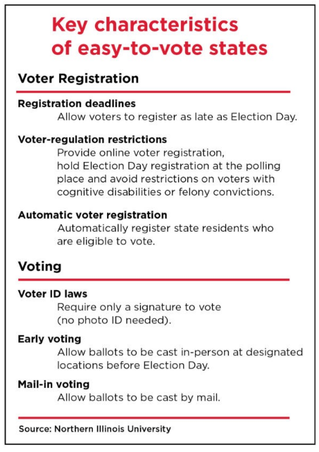
Voting Laws in Texas
10.11.20: Texas Counties Blocked from offering multiple mail-in ballot drop-off locations
9.23.20: Texas Republicans sue to stop Gov. Greg Abbott's extension of early voting period during the pandemic
05.31.21: SB 7 passes, including new ID requirements for mail-in ballots and early voting restrictions

Slide 9
Modeling
Predicting Turnout and Election Results

Slide 10
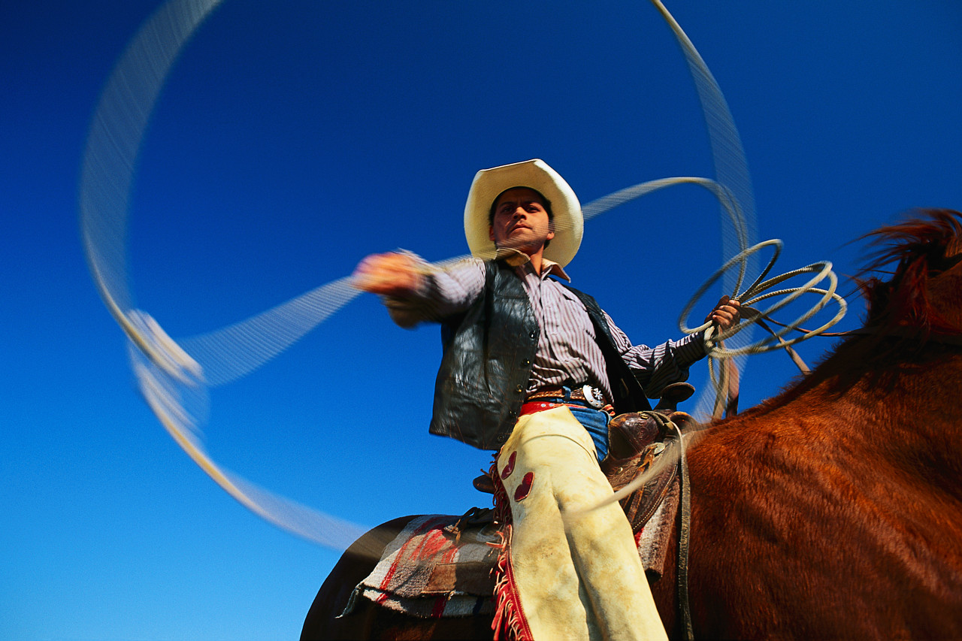
Predicting Voter Turnout by County
We used a LASSO Regression Model
Model trained on 2012 and applied to 2016 & 2020
Why We Chose This Model:
Easy interpretation
Outperformed other regressors (KNeighbors, Random Forest) on RMSE and R2 metrics

Slide 11
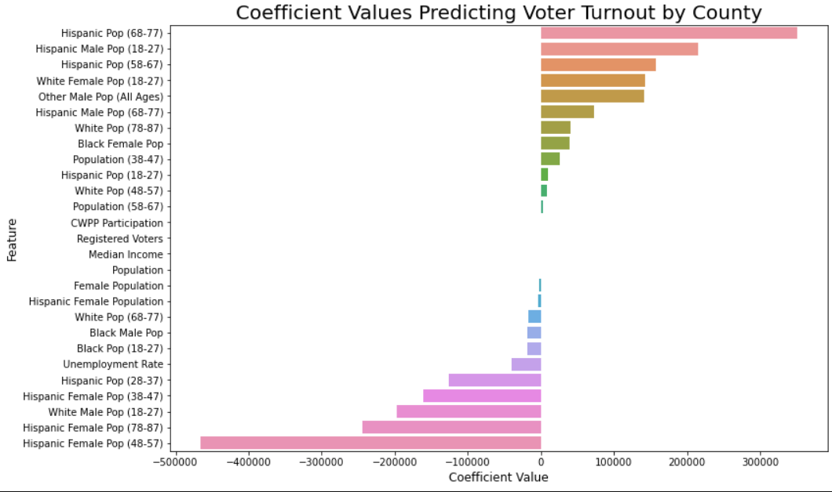




Lasso Coefficients:

Slide 12
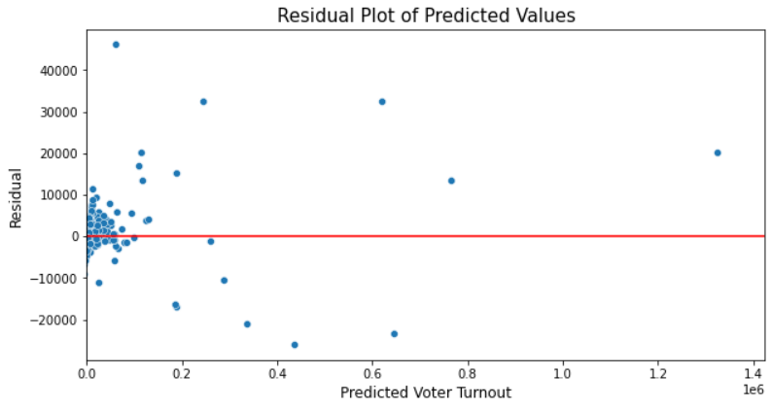
2016 Lasso Results: Overall Voter Turnout
Better at predicting small county turnout
For 2016 we were able to reduce error from the baseline model by 94.55%
2016 Results: Explains 99.7% of variance

Slide 13
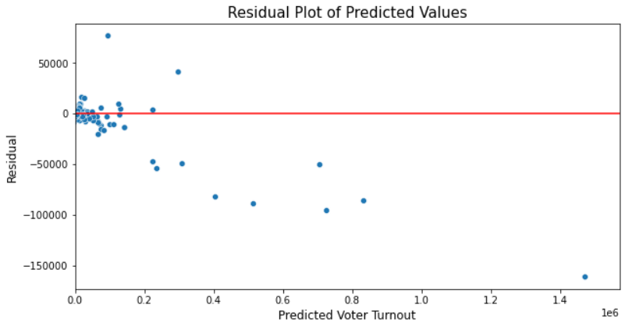
2020 Lasso Results: Overall Voter Turnout
Better at predicting small county turnout
For 2020 we were able to reduce error from the baseline model by 87.97%
2020 Results: Explains 98.55% of variance

Slide 14
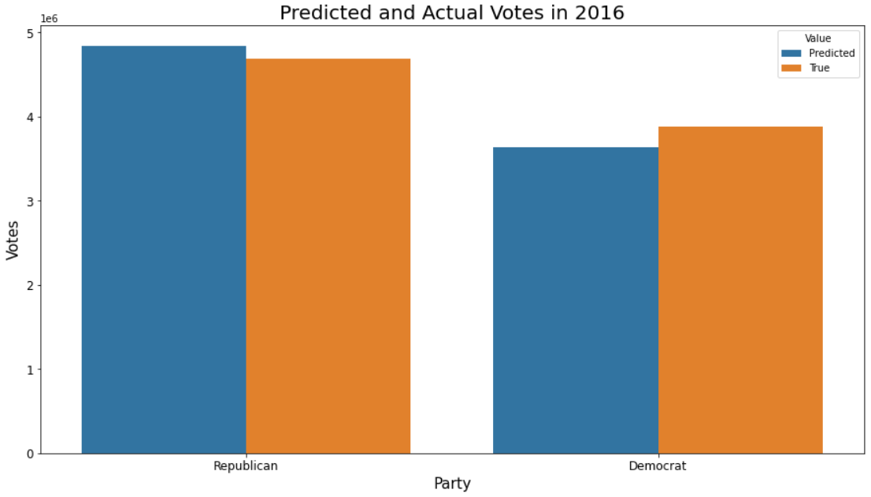
Lasso Results: Party Turnout
In 2016, republican turnout was overpredicted whereas Democrat turnout was underpredicted
This model would predict a Republican victory in 2016

Slide 15
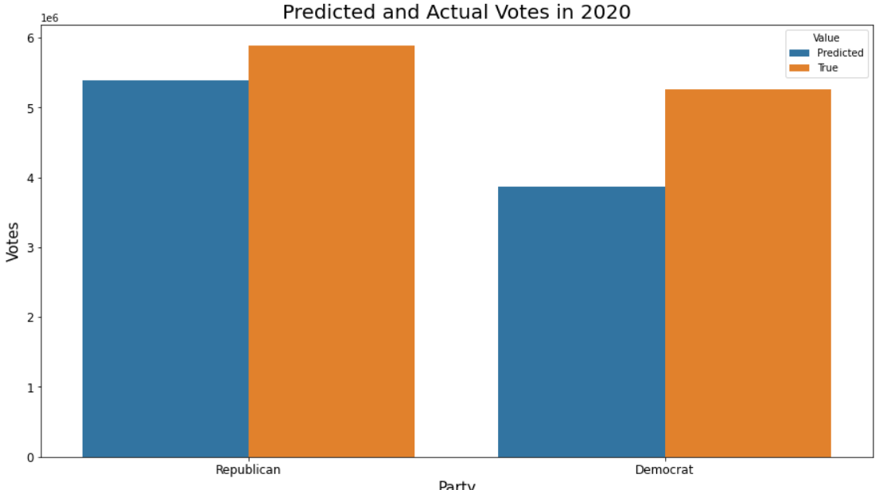
Lasso Results: Party Turnout
In 2020, turnout was underpredicted for both parties. This could be due to very high turnout in 2020
Democrat turnout was more severely underpredicted than Republican turnout

Slide 16
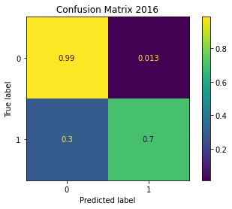
Logistic Regression: County Predictions
1 = Dem, 0 = Rep
We used a logistic regression model to predict which party would have higher turnout in a county
Predicting at the county level is useful for stakeholders

Slide 17
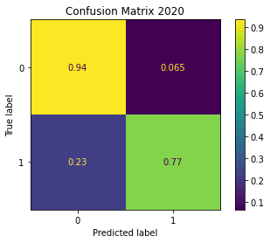
Logistic Regression: County Predictions
1 = Dem, 0 = Rep
In both 2016 & 2020 our model was better at predicting Republican counties
23% of Democratic counties were predicted to be Republican

Slide 18
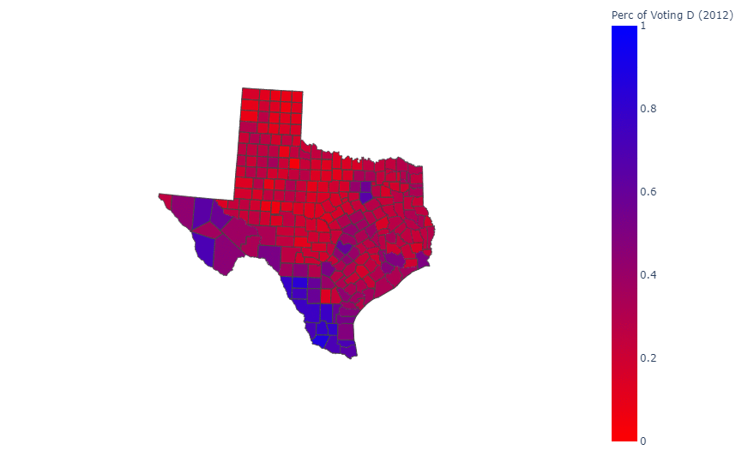
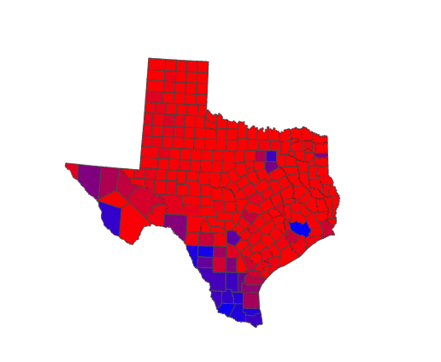
Predicted County Results vs Actual Results
Predicted Results
Actual Results

Slide 19
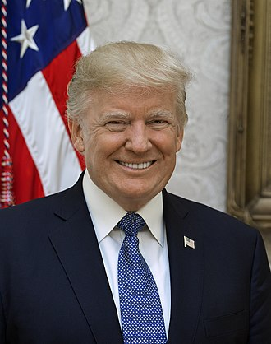
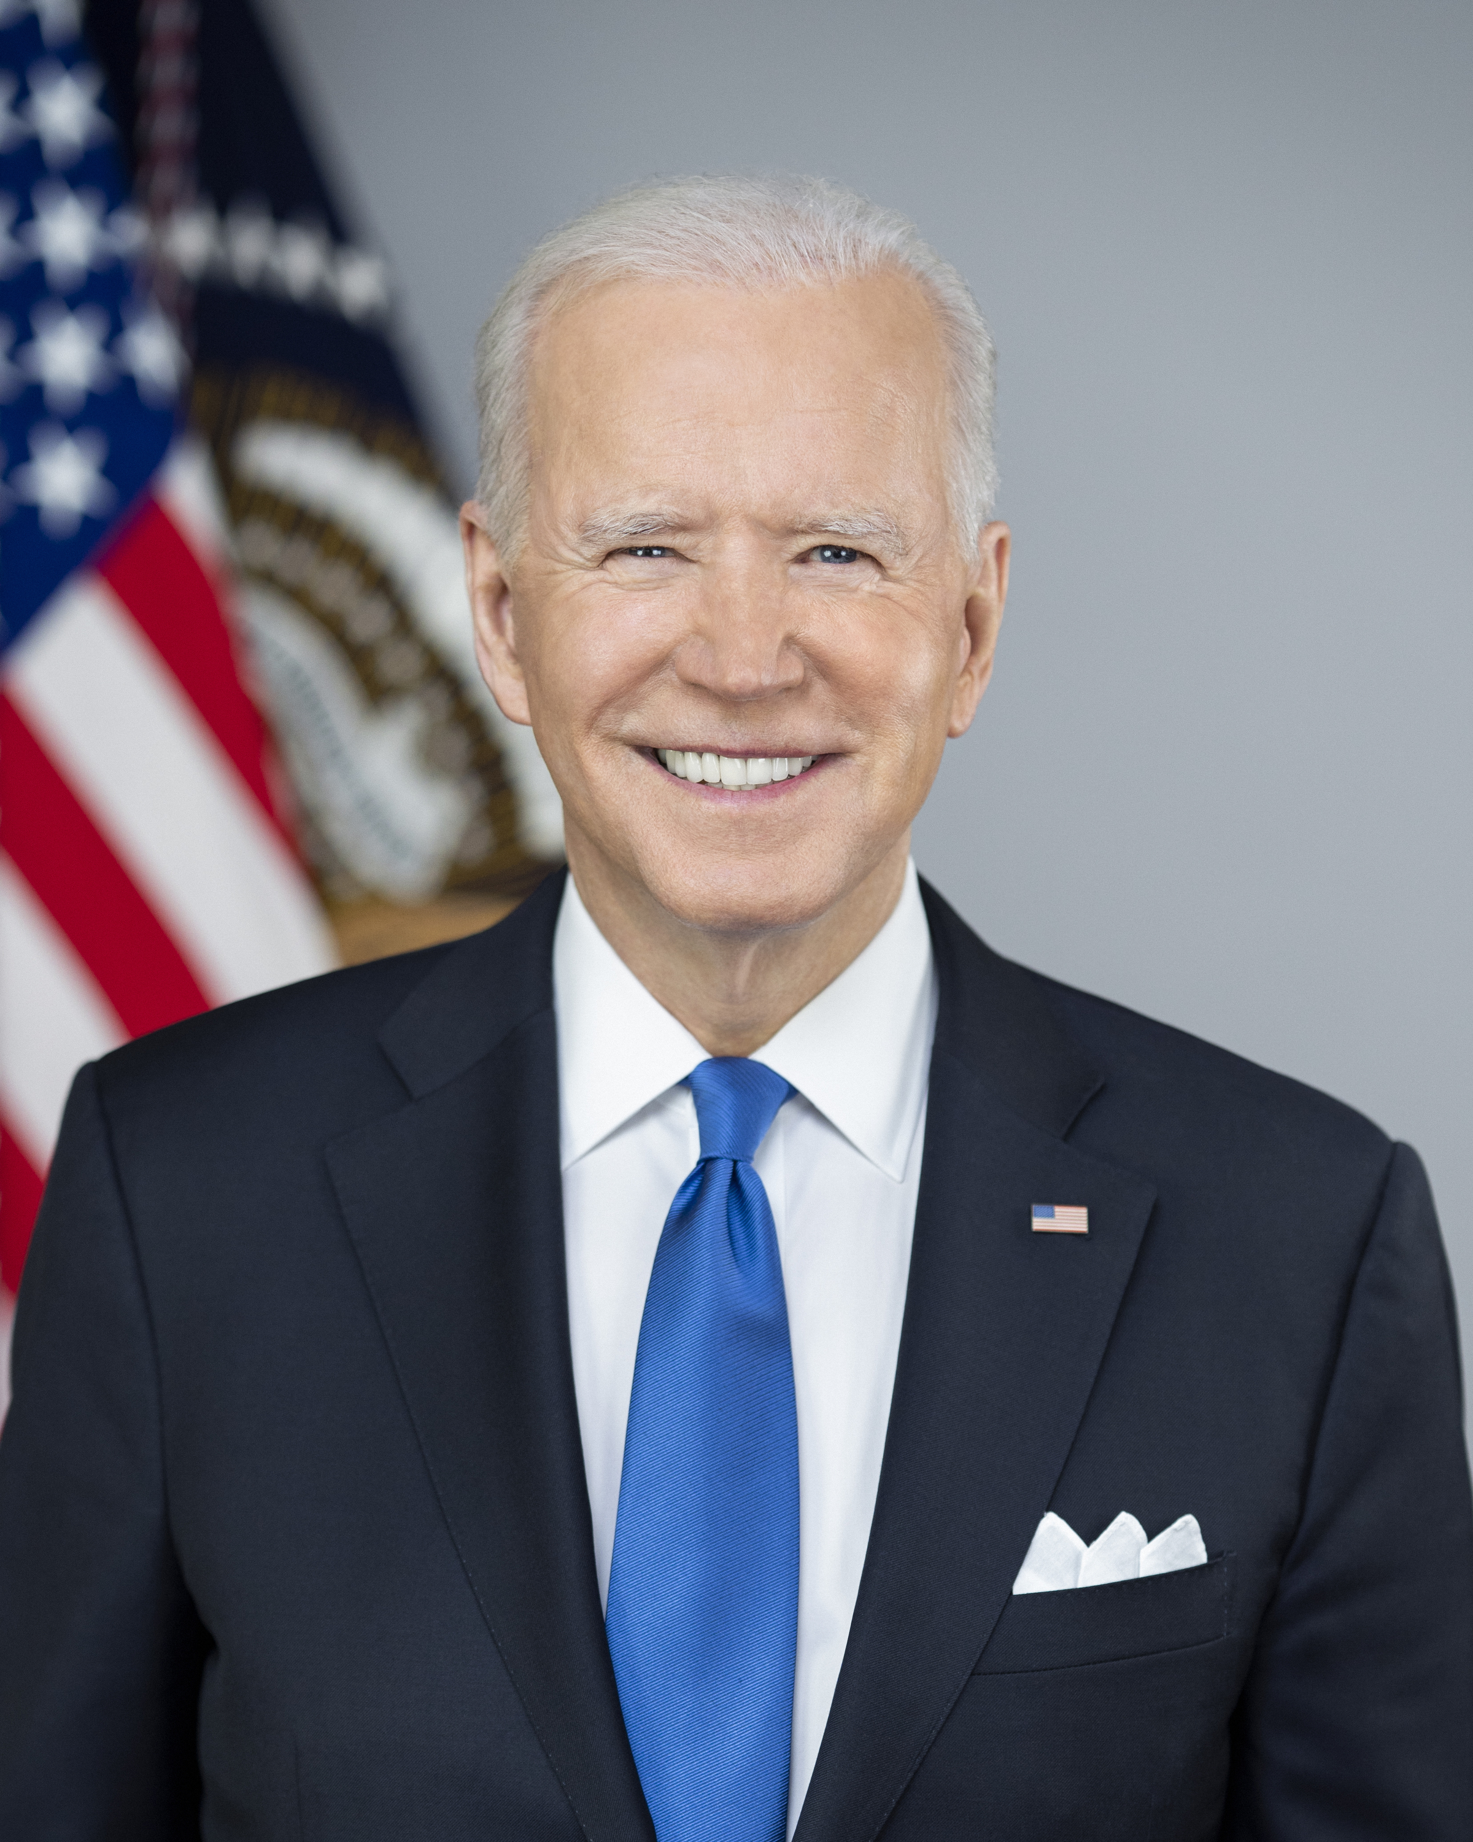
Conclusion
Our Goal
Identify features influencing voter turnout
Use them to predict county results
We Chose to Study Texas Because
Large size (38 electoral votes)
Demographic changes
Voting law controversy
Lasso Model to Predict Turnout
Logistic Regression to Predict Results
Accurate, especially for small counties
Worse for predicting Democratic Turnout
Model was conservative and overpredicted Rep. majority in counties
Useful for identifying swing counties

